Slide 1

DEPARTMENT OF ELECTRONICS AND COMMUNICATION
CHATBOT IN PYTHON
TEAM MEMBERS:
PRIYA DHARSHINI E
NIVETHA S
SARANYA S
RADHIKA G

Slide 2
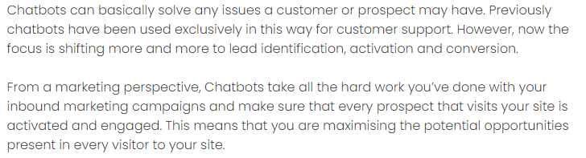
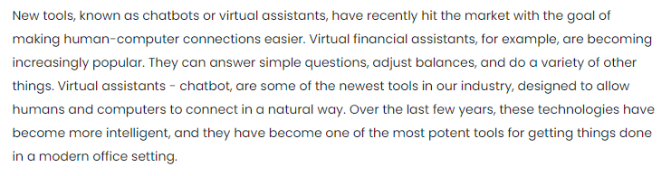
PROBLEM DEFINITION

Slide 3
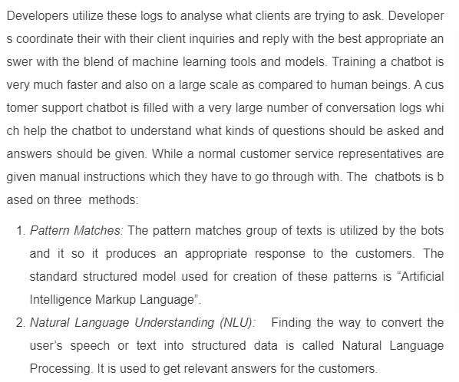
OBJECTIVES

Slide 4
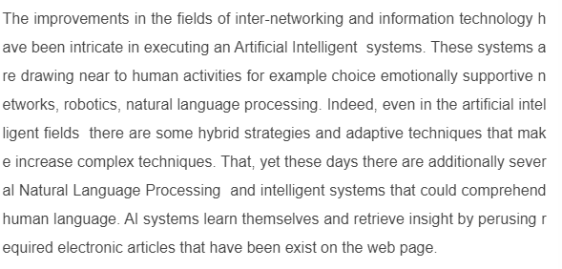
INTRODUCTION

Slide 5
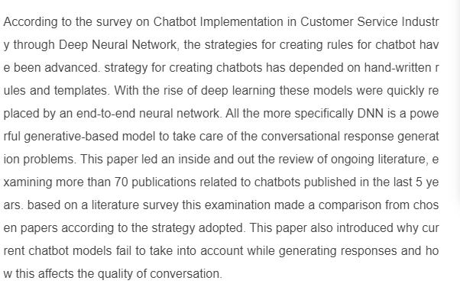
LITERATURE SURVEY

Slide 6
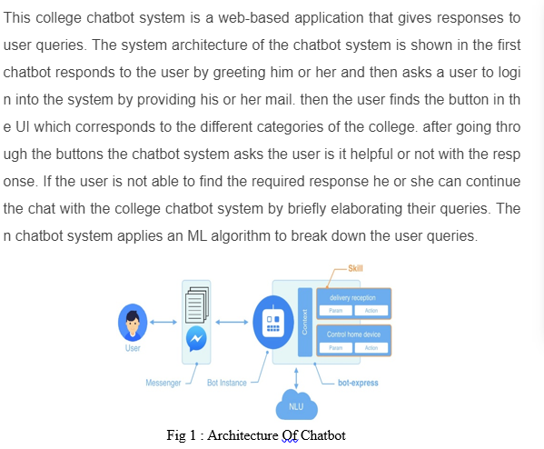
PROPOSED SYSTEM

Slide 7
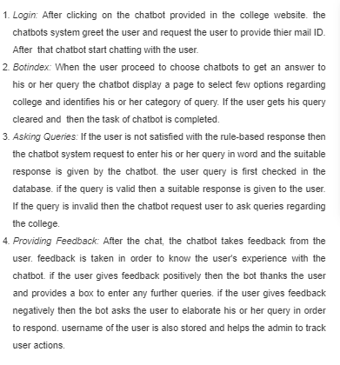

Slide 8
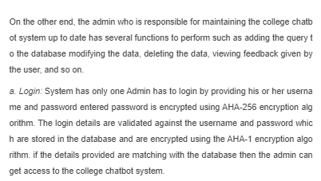
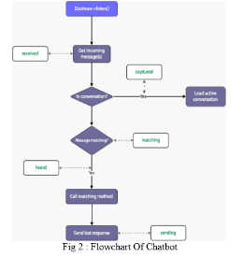
FLOW CHART

Slide 9
FLOW CHART

Slide 10
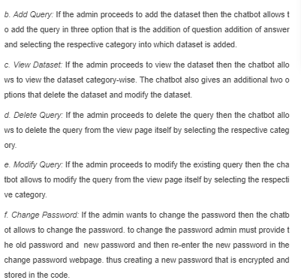

Slide 11
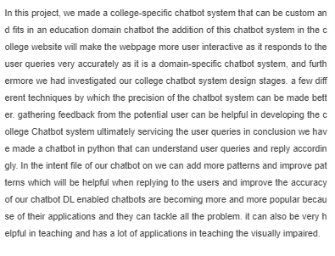
CONCLUSION

